Slide 1
Natural Language Processing (Almost) from Scratch
Collobert et al., 2011
presentation by Jack Morris
12/1/19
https://qdata.github.io/deep2Read/

Slide 2
Section 1 Introduction
Section 2 The Benchmark Tasks
Section 3 The Networks
Section 4 Lots of Unlabeled Data
Section 5 Multi-Task Learning
Section 6 The Temptation
Section 7 Critical Discussion
Section 8 Conclusion

Slide 3
1.1 - Background
Current NLP representation:
Task-specific representations
Simplified, intermediate representation based on
Syntactic information
Semantic information
Benchmark corpora, manually annotated, to evaluate performance
Drawback:
Representation not generally applicable across different corpora
Reveals little about how to improve future natural language representation in general

Slide 4
1.2 Goal
Goal:
Improve on benchmark without task-specific engineering
Proposing:
Intermediate representation extracted from large unlabeled dataset
using a single learning system.
More general than any benchmarks
since no large body of linguistic knowledge is involved.
Approach called “almost from scratch”

Slide 5
Section 1 Introduction
Section 2 The Benchmark Tasks
Section 3 The Networks
Section 4 Lots of Unlabeled Data
Section 5 Multi-Task Learning
Section 6 The Temptation
Section 7 Critical Discussion
Section 8 Conclusion

Slide 6
Section 2: Benchmark Tasks
Part-Of-Speech Tagging (POS)
Chunking
Named Entity Recognition (NES)
Semantic Role Labeling (SRL)
For each task, the state-of-the-art system that did not use external labelled data was chosen as the benchmark system in order to have a fair comparison based on the quality of a system and not the data used for the system.
As a task becomes more complex, more engineered features are needed to train on.

Slide 7
2.1: Part-Of-Speech Tagging
Label each word in a text with its syntactic role
“He sat on the desk” would be labelled as singular noun, past tense verb, preposition, article
Benchmark system: Toutanova et al. (2003)
97.24% per-word accuracy
Used maximum entropy classifiers and inference in bidirectional dependency network
Dataset: Wall Street Journal data

Slide 8
2.2: Chunking (Shallow Parsing)
Label segments of a sentence with syntactic constituents (parts of a sentence that act as a single unit), then label words as in a chunk or begin a chunk
“The tall basketball player jumped over his smaller opponent” would have three chunks, two noun-phrases and a verb-phrase.
Benchmark system: Sha and Pereira (2003)
94.29% F1 Score
Used second-order random fields and a variety of features such as part-of-speech tags
Dataset: CoNLL 2000

Slide 9
2.3: Named Entity Recognition
Tag elements in a text with a category
“Kevin lives in Seattle” would be labelled as person, other, other, location.
Benchmark system: Ando and Zhang (2005)
89.31% F1 Score
Trained a model on NER and two auxiliary unsupervised tasks while permoign Viterbi decoding when testing
Dataset: CoNLL 2003

Slide 10
2.4: Semantic Role Labeling
Assigns a role to each syntactic constituent in a text
Typically assigns roles between ARG0 and 5 to each argument of a verb
“John ate the apple” would be tagged as ARG0, verb, ARG1.
Benchmark system: Koomen et al. (2005)
77.92% F1 Score
Used Winnow-like classifiers along with a decoding stage
Dataset: CoNLL 2005

Slide 11
Section 1 Introduction
Section 2 The Benchmark Tasks
Section 3 The Networks
Section 4 Lots of Unlabeled Data
Section 5 Multi-Task Learning
Section 6 The Temptation
Section 7 Critical Discussion
Section 8 Conclusion

Slide 12
Section 3: The Networks
Old approach: hand-design task-specific features, feed to SVM
Feature selection is task-dependent
Complex feature have high computational cost
New approach: pre-process as little as possible, train NN in E2E fashion
NN learns feature extraction
Features automatically trained to be relevant to task

Slide 13

3.1: Notation
Think of NN as a composition of functions
Given matrix A, [A]_{i,j} is value at row i, column j
Window of size d^{win} around column i
Sequence of {x₁,x₂,...,x_{T}} written as [x]₁^{T}

Slide 14
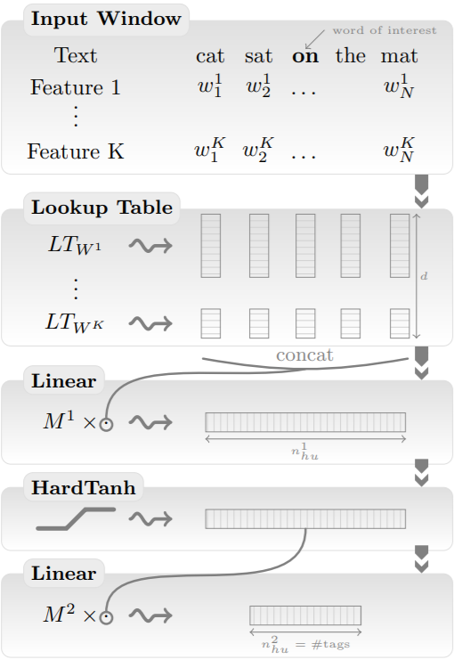
3.3.1: Window Approach

Slide 15
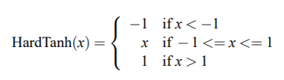
HardTanh Layer

Slide 16
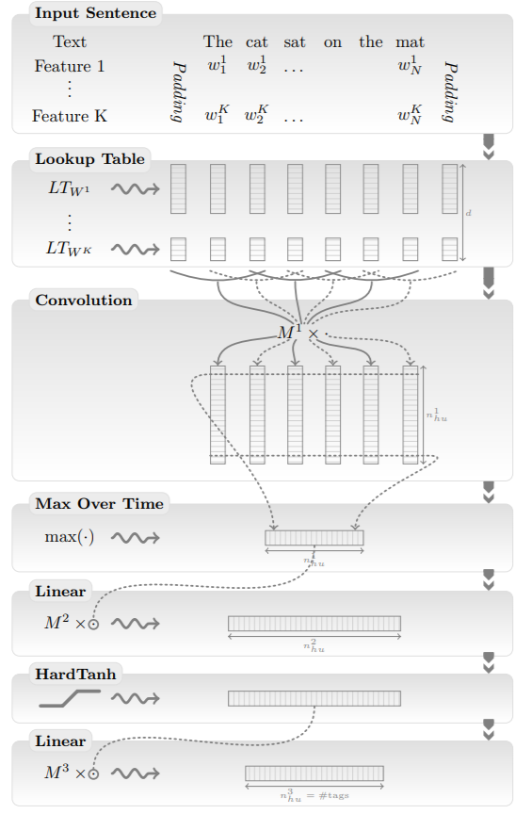
3.3.2: Sentence approach

Slide 17
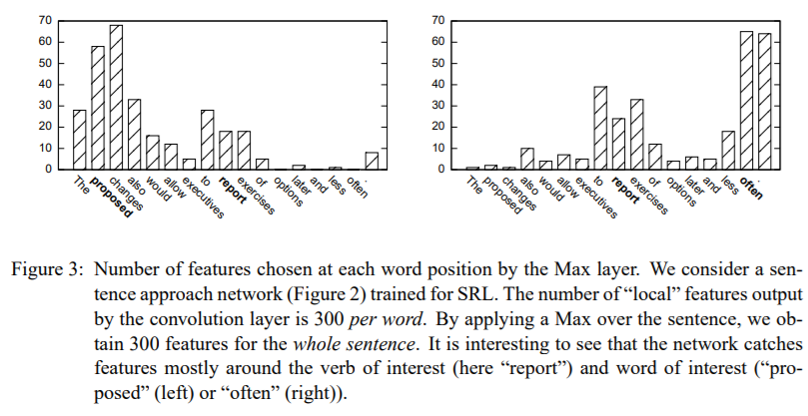
3.3.2: Sentence approach
For SRL, add features for relative distance to verb considered and word being tagged

Slide 18
3.4: Training
Word-level Log-likelihood (WLL): Cross-entropy loss, we have covered that before
Sentence-level Log-likelihood (SLL): Consider which “tag paths” are valid
Construct transition matrix representing validity of jumping from tag i to tag j in successive words. This is trained along with network.
Add transition scores, network scores when scoring tag paths.
Trained using Stochastic Gradient Ascent

Slide 19
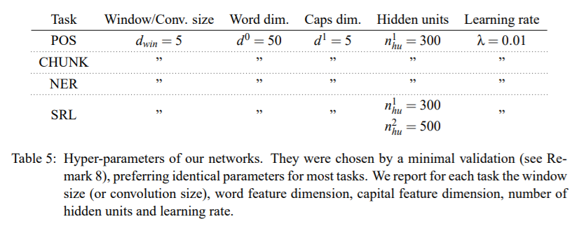
3.5: Supervised Training Results

Slide 20
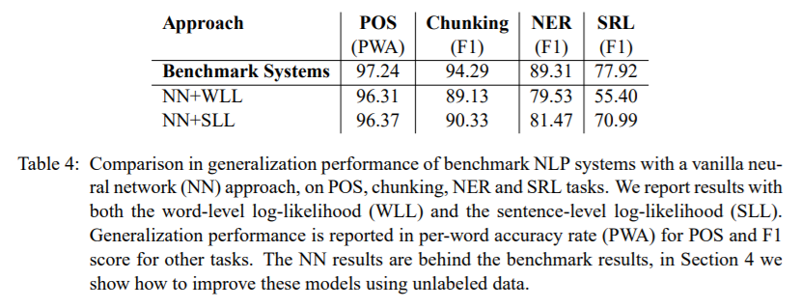
3.5: Supervised Training Results

Slide 21
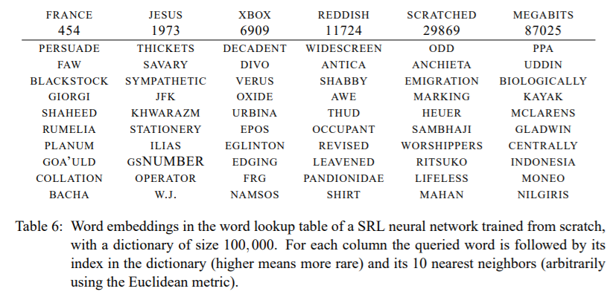
3.5: Supervised Training Results

Slide 22
Section 1 Introduction
Section 2 The Benchmark Tasks
Section 3 The Networks
Section 4 Lots of Unlabeled Data
Section 5 Multi-Task Learning
Section 6 The Temptation
Section 7 Critical Discussion
Section 8 Conclusion

Slide 23
Section 4: Lots of Unlabeled Data
We want word embeddings with more information than the ones in the table of the SRL neural network in 3.5
We will see how to improve our poor embeddings using large unlabeled data sets
New embeddings to make new word lookup tables for our networks

Slide 24
4.1: Data Sets
Entire English Wikipedia
Removed all paragraphs non-Roman characters and markups
Tokenized, 631 million words
Dictionary of 100,000 words from Wall Street Journal
Reuters RCV1 data set
221 million words
Extended dictionary to 130,000 words adding the 30,000 most common words in Reuters
We can determine if adding this data set can yield improvements

Slide 25
4.2: Ranking Criterion vs. Entropy Criterion
Used data sets to train language models that output scores for text
Most trainable parameters are in the lookup tables
Previous works: Bengio and Ducharme (2001), Schwenk and Gauvain (2002)
Estimate the probability of a word given previous words in the sentence
Suggests cross-entropy criterion
Computing normalization term is demanding given large dictionary
Neither work gave significant word embeddings
We can’t really use the 0.2 bit/character entropy difference between humans and n-gram models to learn grammar
Entropy criterion lacks dynamical range because its value is mostly determined by the most frequent phrases
To learn syntax, rare but legal phrases are no less significant than common phrases

Slide 26

4.2: Ranking Criterion vs. Entropy Criterion
They propose a pairwise ranking approach
We do not want to emphasize a common phrase over a rare but legal phrase
Window network approach
Okanohara and Tsujii (2007) used a similar approach but with binary classifications and a kernel classifier, not with word embeddings
Smith and Eisner (2005), “negative” neighborhood

Slide 27
4.3: Training Language Models
Trained on SGD of the ranking criterion, sampling sentence-word pairs each iteration
Cannot tune global hyperparameters
Initialize networks with embeddings from earlier networks
Train a succession of networks using increasingly large dictionaries, each network being initialized with the embeddings of the previous network (sizes and switching times arbitrary)
Breeding
Child networks initialized with parent’s embeddings and different training parameters based on past generation’s success (learning rate, word embedding dimensions, # of hidden dimensions, etc.)

Slide 28
4.3: Training Language Models
LM1
Window size 11, hidden layer with 100 units
Trained on Wikipedia with dictionary sizes of 5k, 10k, 30k, 50k, and 100k most common Wall Street Journal words
4 weeks
LM2
Initialized with LM1 embeddings, same dimensions as LM1
Trained for another 3 weeks on Wikipedia+Reuters with 130k-word dictionary

Slide 29
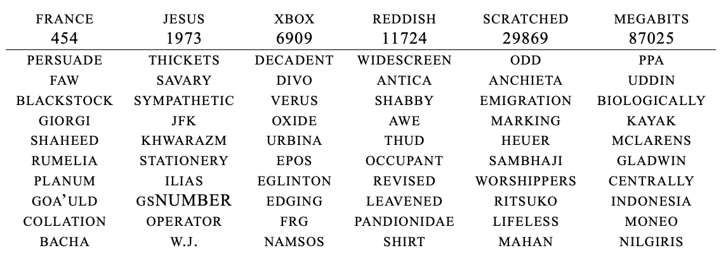
4.4: Embeddings (Before)

Slide 30
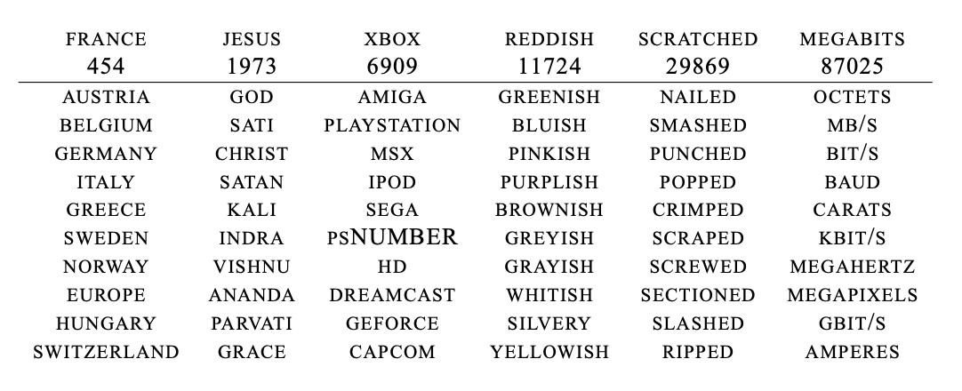
4.4: Embeddings (After - LM1)

Slide 31
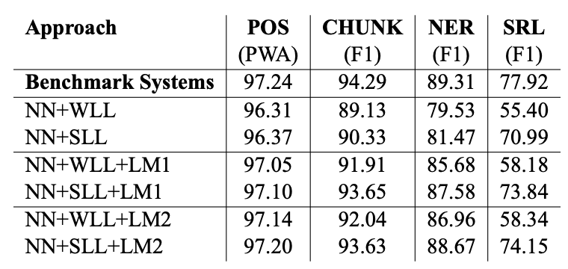
4.5: Semi-supervised Benchmark Results
Semi-supervised learning
Ad hoc
Self-training (pseudo-labels)
Parameter-sharing

Slide 32
4.6: Ranking and Language
Syntax is a prerequisite for semantic role labeling
Existing semantic role labeling systems use parse trees, parsers know prior info about syntax
They can’t use parse trees with unlabeled data
Difficult to see how ranking criterion can obtain this information
Ranking similar to operator grammars (Harris, 1968), which defines a ranking criterion when testing if two sentences are semantically related by a transformation
They conclude that ranking criterion has the potential to extract strong syntactic and semantic information
Our language models are too restrictive for our goals

Slide 33
Section 1 Introduction
Section 2 The Benchmark Tasks
Section 3 The Networks
Section 4 Lots of Unlabeled Data
Section 5 Multi-Task Learning
Section 6 The Temptation
Section 7 Critical Discussion
Section 8 Conclusion

Slide 34
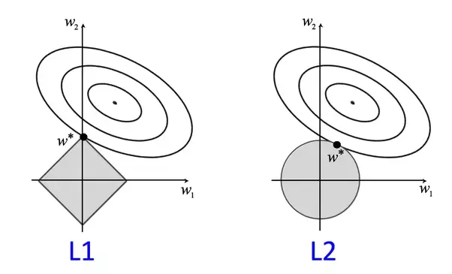
5. Multi-Task Learning
Features trained for one task can be useful for related tasks
Already seen this with unsupervised word embeddings
Has since become very popular in Computer Vision and RL
Can be seen as a form of regularization

Slide 35
5.1 Joint Decoding versus Joint Training
Joint Decoding
Probabilistic framework for inference across models
Used in multi-modal domains like speech recognition

Slide 36
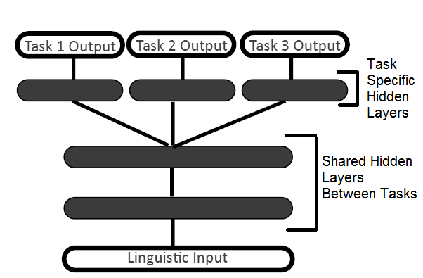
5.1 Joint Decoding versus Joint Training
Joint Training
One network with multiple outputs
Need labels for each task for every input
Loss as linear combination of tasks
What to do when labels correspond to different training sets?
Iterative gradient updates
Theoretically unstable, but works in practice

Slide 37
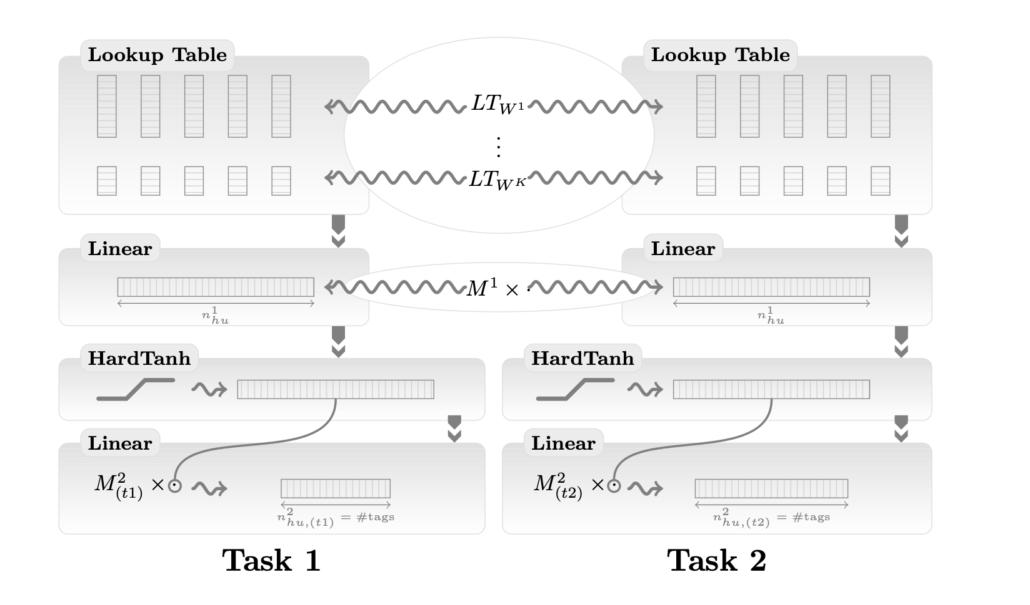
5.2 Multi-Task Benchmark Results
In this work specifically:
Shared lookup tables
Shared first linear layer in window architecture, first conv layer in sentence architecture
Alternate between tasks for gradient updates

Slide 38
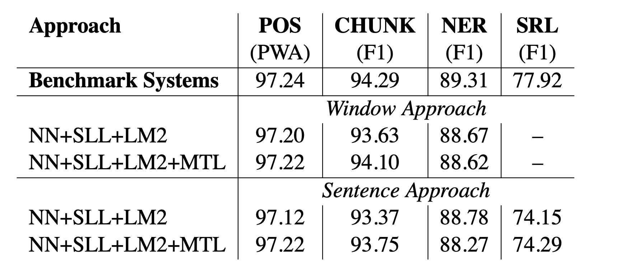
5.2 Multi-Task Benchmark Results

Slide 39
Section 1 Introduction
Section 2 The Benchmark Tasks
Section 3 The Networks
Section 4 Lots of Unlabeled Data
Section 5 Multi-Task Learning
Section 6 The Temptation
Section 7 Critical Discussion
Section 8 Conclusion

Slide 40
Section 6: The Temptation
Results so far have been (almost*) from scratch, as originally intended
*almost: since we preprocessed the data into raw words-- if we really worked from scratch, we would start from characters (or pictures of characters!)
This has disregarded a large amount of linguistic knowledge
We’ve shown that, by using large unlabeled datasets, we can still get near state-of-the-art performance
So how much better can we get if we increase “task-specific engineering” using known techniques from NLP literature?

Slide 41
6.1: Suffixes
Statistically, suffixes are strong predictors of word syntactic function
This is useful for part-of-speech taggers (the “POS system”)
Let’s add discrete word features that represent the last two characters of each word
Size of suffix dictionary: 455
Improves POS tagging score from 97.20 to 97.29 + (0.09)

Slide 42
6.2 Gazetteers
A “gazetteer” is a dictionary containing well-known named entities
As you might imagine, this is useful for the named entity recognition (NER) task
Four gazetteer categories: (1) locations, (2) person names, (3) organizations, (4) miscellaneous
Add 4 additional feature for each word that are “on” and “off” if the word is found in each of four categories
Increases NER score from 88.67 to 89.59 (+0.92)

Slide 43
6.3 Cascading
Cascading: using features outputted by one task as input for another task
“Conventional NLP systems often use features obtained from the output of other preexisting NLP systems”
Can we improve CHUNK and NER tasks by adding POS tags as features?
Yes! Improvement on CHUNK from 93.63 to 94.32 (+0.69)

Slide 44
6.3 Ensembles
Ensemble models combine the predictions of multiple diverse models to predict an outcome
Constructing ensembles of classifiers is the best way to trade computational efficiency for generalization performance
Many NLP systems achieve state-of-the-art performance by combining the outputs of multiple classifiers
Because neural networks are nonconvex, training runs with different initializations usually give different solutions

Slide 45
6.3 Ensembles [cont’d]
Try ten training runs on each POS, CHUNK, NER task, with ten different initializations
Voting leads to a small improvement (.1 to .3) in average network performance
They also tried adding a linear layer to the outputs of the classifiers and training that way: this did not outperform the simple voting
Performance variability among the networks is not very large, anyway

Slide 46
6.5 Parsing
Some past researchers have argued that syntactic parsing is necessary for the SRL (semantic role labeling) task
So far, we’ve gotten close to state-of-the-art on SRL without parse trees at all 😲
Add parse tree features to the system: Increase score from 74.15 to 77.92 (+3.8%)

Slide 47
6.6 Word Features
They created their word embeddings via language modelling, instead of using previously established algorithms (like “Brown clustering”)
A natural question: how to these embeddings compare? Is one more useful than the other?
Answer: the new word embeddings do better! (very slightly)

Slide 48
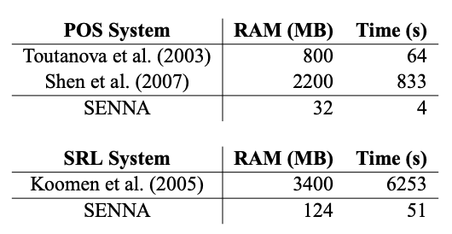
6.7 Engineering a Sweet Spot
Implement a standalone version of the architecture and just try to get the best scores possible
They engineered their system from scratch and it’s over 200x faster than the SOTA system and uses much less RAM
wow

Slide 49
Section 1 Introduction
Section 2 The Benchmark Tasks
Section 3 The Networks
Section 4 Lots of Unlabeled Data
Section 5 Multi-Task Learning
Section 6 The Temptation
Section 7 Critical Discussion
Section 8 Conclusion

Slide 50
Section 7: Critical Discussion
Why abandon all the pre-existing knowledge of engineering NLP features and instead pursue end-to-end learning?
Task-specific features do not transfer well to other tasks → Cannot have a method that generalize well to all tasks.
Want something generalizable
Why neural networks?
It’s able to learn hidden representation of words.
Learning algorithm scales linearly, which allows it to take advantage of hardware advancements.

Slide 51
Section 1 Introduction
Section 2 The Benchmark Tasks
Section 3 The Networks
Section 4 Lots of Unlabeled Data
Section 5 Multi-Task Learning
Section 6 The Temptation
Section 7 Critical Discussion
Section 8 Conclusion

Slide 52
Section 8: Conclusion
Contribution:
Multilayer neural network that can learn to handle a number of NLP tasks with both speed and accuracy.
More broadly, an end-to-end learning system that can learn useful features from unlabeled data set instead of relying on engineered features.

